Slide 1

MIS 547
Cloud Computing

Slide 2
Admin
Quiz 3 Opens Today (Due on Sunday at midnight)
01
Assignment 3 Due MONDAY at midnight
02
Group project formation- Slack me if there are any issued
04
Remember that classes are online next week
03

Slide 3
Note for students
This lecture assumes that you have some familiarity with SQL databases. Specifically, you should be familiar with:
One or more relational databases, such as MySQL, PostgreSQL, Microsoft SQL Server, etc.
The basic structure/schemas of relational databases, including row-oriented data, entities and attributes, primary keys, and foreign keys.
Querying SQL databases.
If you aren’t familiar with SQL and relational databases, I strongly recommend that before you continue this lecture, you review the following mini-course on SQL and relational databases:

Slide 4
Databases
What’s covered in this lecture:
Self-managed databases in the cloud
Agenda
Cloud databases
Cloud native databases
Cloud managed databases
NoSQL

Slide 5
Lecture 6: Cloud Databases

Slide 6
Database Options in the Cloud
SELF-MANAGED
CSP provides hardware, hypervisor to run VM, and API or tools to manage your deployment
(CLOUD) MANAGED
The CSP provides hardware and server software; the CSP updates, configures, and backups the database
CSPs offer both traditional databases and cloud-native databases
You need to create a VM running an OS and your application

Slide 7
Cloud Databases
SELF-MANAGED
(CLOUD) MANAGED
TRADITIONAL
CLOUD-NATIVE
SQL
NoSQL
SQL
NoSQL

Slide 8
Self-Managed Cloud Databases
SELF-MANAGED
The customer:
Provisions the infrastructure (VMs)
Installs the needed software
Ensures high availability and scaling
Creates user accounts
Creates schemas
Manages connections
Handles backups
TRADITIONAL
We don’t always use the term “self-managed”- you’ll see different terminology, like “self-provisioned”
SQL
NoSQL

Slide 9
Self-Managed Cloud Databases
SELF-MANAGED
You can run any kind of database you want to! By “traditional” database, we mean databases that aren’t purpose-built for the cloud.
Any database you would run locally, you can run on a VM.
TRADITIONAL
SQL
NoSQL
This includes familiar SQL databases and also NoSQL databases

Slide 10
Traditional SQL Databases
SELF-MANAGED
TRADITIONAL
SQL
MySQL
SQL Server
Oracle
Examples of SQL databases
PostgreSQL
MariaDB

Slide 11
Traditional Databases
SELF-MANAGED
Comparing common SQL databases
Database | Vendor/ License | SQL Syntax | What makes it cool
MySQL
SQL Server
Oracle SQL
PostgreSQL
MariaDB
TRADITIONAL
SQL
MySQL
SQL Server
Oracle
PostgreSQL
MariaDB

Slide 12
Types of Cloud Databases
SELF-MANAGED
TRADITIONAL
NoSQL
MongoDB
Cassandra
Examples of NoSQL Databases
CouchDB
Redis

Slide 13
What are NoSQL Databases?

Slide 14
NoSQL Databases
NoSQL (sometimes called Not Only SQL) databases operate on a different paradigm than the more familiar SQL databases.
Capable of storing more diverse datatypes and relationships

Slide 15
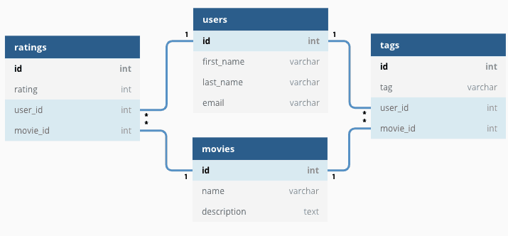
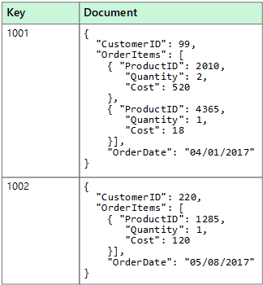
Relational Vs Non-Relational DATABASES
Relational
Non-Relational

Slide 16
Types of NoSQL Databases
Key/ value databases
Document databases
Graph databases
Search databases
Time series databases
Ledger databases
In-memory databases
Vector databases

Slide 17
Relational VS. Non-Relational DATABASES
Relational
Non-Relational
Stores data in tables
Need to define schema (structure of tables)
Structured data
ACID: Atomicity, consistency, isolation, durability
Stores data as key-value, JSON, nodes, vectors, etc.
Schema-less
More flexible
BASE: Basically available, soft-state, eventually consistent

Slide 18
Relational Vs. Non-Relational Database Performance
Relational
Non-Relational
Performance factors
Relies on disk subsystem
Use SSD, optimize the disk by configuring with RAID (Redundant array of independent disks) arrays
Need to optimize indexes, table structures, queries
Depends on network latency, hardware cluster size, calling application
Increase cluster size, minimize network latency, index and cache
Higher performance and scalability for specific use cases
Performance improvement
Performance
optimization

Slide 19
Scaling Relational and Non-Relational Databases

Slide 20
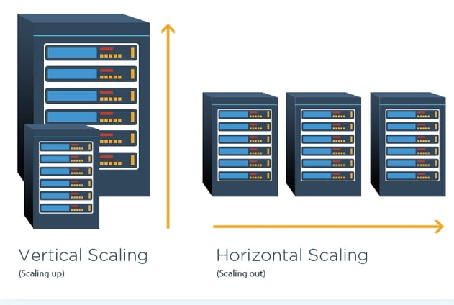
Recall: Vertical and horizontal SCALING

Slide 21
Recall: vertical and horizontal Scaling
 | Horizontal Scaling | Vertical Scaling
Description | Increase of decrease the number of nodes in a system to handle an increase or decrease in workload | Increase or decrease the resources of a single node in a system to handle increased or reduced workload
Example | Add or reduce the # of VMs in a cluster | Add or reduce the CPU or memory of VM
Workload Distribution | Workload is distributed across multiple nodes; parts of the workload resides on these different nodes | A single node handles the entire workload
Complexity | Higher | Lower
Downtime | No | Yes
Load balancing | Necessary to actively distribute workload across the multiple nodes | Not required in the single node
Implementation | Takes more time, expertise, and effort | Takes less time, expertise, and effort

Slide 22
Vertical Scaling
Pros
Cons
Less complex process communication
Less complicated maintenance
Less need for software changes
Higher possibility for downtime
Single point of failure
Upgrade limitations

Slide 23
Horizontal Scaling
Pros
Cons
Fewer periods of downtime
Increase resilience and fault tolerance
Increased performance
Increased complexity of maintenance and operations
Increased initial costs

Slide 24
Scaling Relational Vs. Non-Relational Databases
Relational and non-relational databases have different considerations when scaling.
To scale SQL (relational) databases we must very carefully manage indices.
Recall the idea of database sharding from MIS531
In NoSQL databases, scaling can be handled in a very different way...

Slide 25
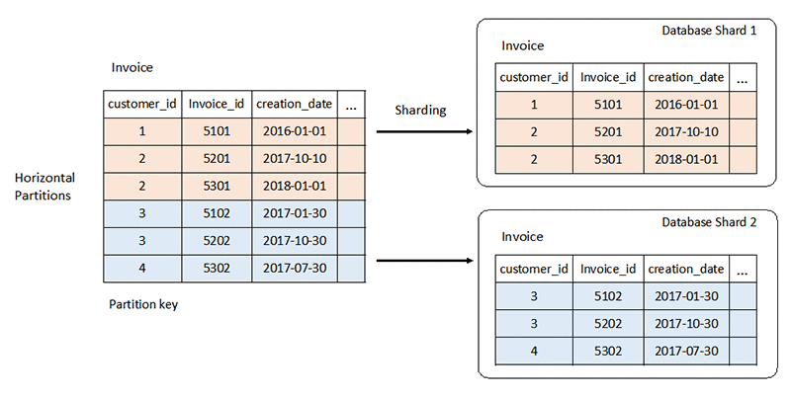
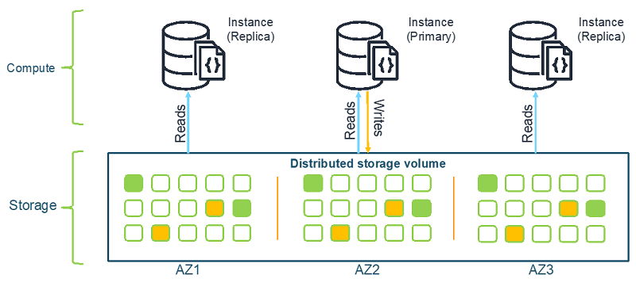
Scaling Databases
Relational
Non-Relational

Slide 26
NoSQL Databases
High scalability
High availability
Easy replication
Fast performance
Big data capacity
Many kinds of data
Many kinds of relationships
NoSQL

Slide 27
NOSQL Databases: Case Studies

Slide 28
Vector Databases
What is a vector?
A 1 x n dimensional numeric representation of data
We often represent text as high-dimensional vectors
These vectors are generated using embedding techniques, ranging from simple n-grams to complex transformer-based techniques
CBOW
Word2Vec
BERT (Bidirectional Encoding Representation Transformer)
Global Vectors (GLoVE)
ELMo (Embeddings from Language Models)

Slide 29
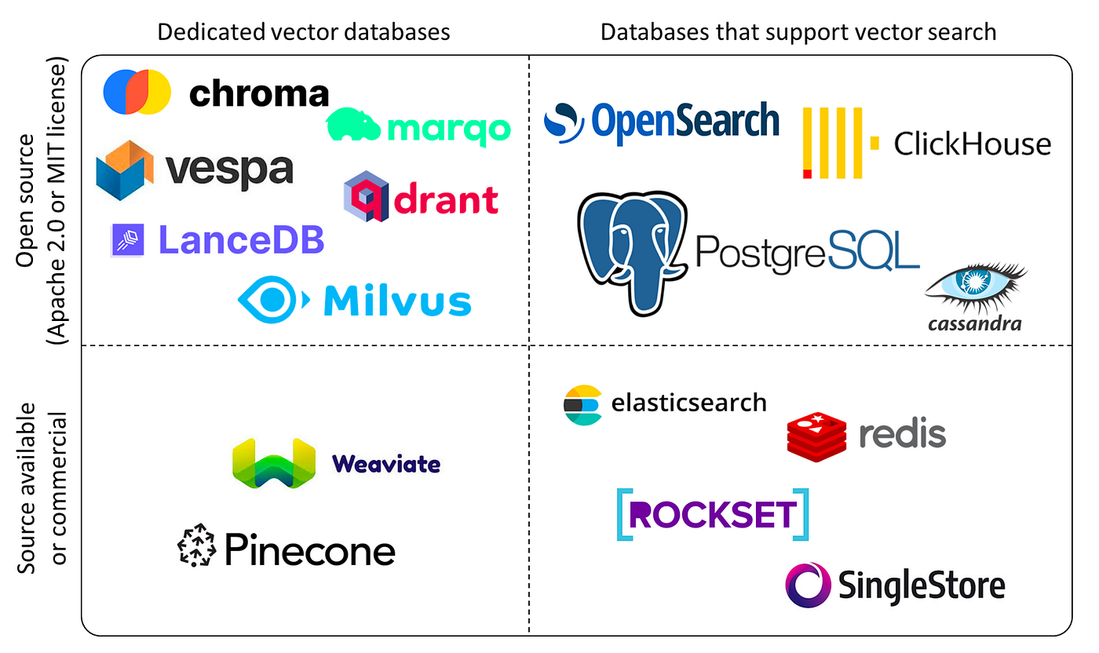
Vector Databases
Frequently used in NLP and Semantic Search
Source: DataCamp

Slide 30
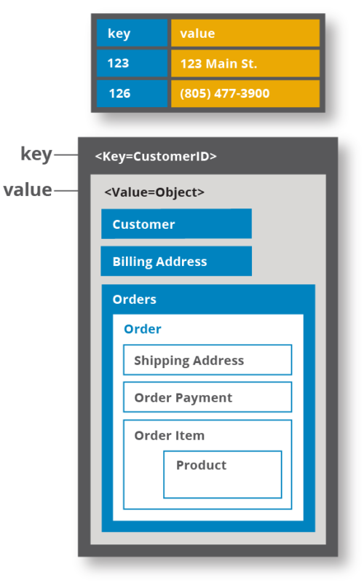
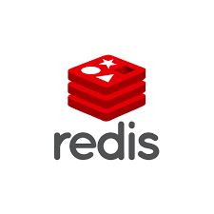
Key-Value Stores
Key value databases store data as a series of unique identifiers, called keys, which each have a value associated with them.
Values can be nested
This provides flexibility in your data model
Source: Hazlecast

Slide 31
Document Databases
Key | Document
document1 | { “id”:1, “name”: “ProfZ”, “active”: ”true”, “is_student”:”false”, “orgs”: { “org1”:”DO”, “org2”: “UA”, “org3”:ZC } }
document2 | { “id”:2, “name”:”Payton”, “active”:”true”, “is_student”:”false”, “orgs”: { “org1”:”USAF” } }
document3 | { “id”:3 “name”:”Vetri”, “active”:”true”, “is_student”:”true, “is_TA”:”true” }
Manage data as “documents”
Each document contains a JSON (or JSON-like) blob
Each document can have unique fields
Documents are organized into collections

Slide 32
How to Self-Manage your Database in the Cloud
SELF-MANAGED
TRADITIONAL
When you use a self-managed database, you have all of the same installation, configuration, security, availability, and management considerations that you may have with an on-prem database.
SQL
NoSQL
MySQL
MongoDB
SQL Server
Cassandra
Oracle
CouchDB
PostgreSQL
Redis
MariaDB

Slide 33
How to Self-Manage your Database in the Cloud
SELF-MANAGED
TRADITIONAL
SQL
NoSQL
MySQL
MongoDB
SQL Server
Cassandra
Oracle
CouchDB
PostgreSQL
Redis
MariaDB
VM
(Storage or Memory Optimized, depending on the size/type of the DB)
Block Storage
Step 1: Create a VM & attach block storage

Slide 34
How to Self-Manage your Database in the Cloud
SELF-MANAGED
TRADITIONAL
SQL
NoSQL
MySQL
MongoDB
SQL Server
Cassandra
Oracle
CouchDB
PostgreSQL
Redis
Step 2: Install a DB server on the VM
Database server software
MariaDB
VM
(Storage or Memory Optimized, depending on the size/type of the DB)
Block Storage
Note: specialized images that are optimized for a particular database may be available from the CSP!

Slide 35
How to Self-Manage your Database in the Cloud
SELF-MANAGED
TRADITIONAL
SQL
NoSQL
MySQL
MongoDB
SQL Server
Cassandra
Step 3: Configure network stack
Oracle
Network stack
CouchDB
PostgreSQL
Redis
Database server software
MariaDB
VM
(Storage or Memory Optimized, depending on the size/type of the DB)
Block Storage

Slide 36
How to Self-Manage your Database in the Cloud
SELF-MANAGED
TRADITIONAL
SQL
NoSQL
MySQL
MongoDB
Step 4: Configure users and access
Users & Permissions
SQL Server
Cassandra
Oracle
Network stack
CouchDB
PostgreSQL
Redis
Database server software
MariaDB
VM
(Storage or Memory Optimized, depending on the size/type of the DB)
Block Storage

Slide 37
How to Self-Manage your Database in the Cloud
SELF-MANAGED
TRADITIONAL
SQL
NoSQL
Step 5: Define schemas
Schema
MySQL
MongoDB
Users & Permissions
SQL Server
Cassandra
Oracle
Network stack
CouchDB
PostgreSQL
Redis
Database server software
MariaDB
VM
(Storage or Memory Optimized, depending on the size/type of the DB)
Block Storage

Slide 38
How to Self-Manage your Database in the Cloud
SELF-MANAGED
Ongoing: Patching, version upgrades, performance monitoring, security monitoring, optimizing redundancy, scaling, etc.
TRADITIONAL
SQL
NoSQL
Schema
MySQL
MongoDB
Users & Permissions
SQL Server
Cassandra
Oracle
Network stack
CouchDB
PostgreSQL
Redis
Database server software
MariaDB
VM
(Storage or Memory Optimized, depending on the size/type of the DB)
Block Storage

Slide 39
Managed Databases

Slide 40
Managed Databases
“Managed databases” == “Cloud Managed databases”
”Managed database” will never mean user-managed or self-managed database.
In managed databases, the CSP handles a lot of the heavy lifting for running databases in the cloud.
Because the CSP runs the DB, you are limited to the choices the CSP makes around DB offerings, versioning, and patching.

Slide 41
Managed Databases
CSP handles
Installation
Updates
Configuration
Backups
Scaling
Customer handles
Collation
Cursors
Connections
Schemas
Data provenance
Notes:
The CSP can provide a license for proprietary DBs and includes that cost with the cost of the cloud service.

Slide 42
Shared Responsibility Model
Cloud responsibility: security of the cloud
Customer responsibility: security in the cloud
Access management
Monitoring
Auditing access attempts

Slide 43
Cloud Databases
SELF-MANAGED
(CLOUD) MANAGED
TRADITIONAL
CLOUD-NATIVE
SQL
NoSQL
SQL
NoSQL

Slide 44
Cloud-Managed Databases
CLOUD-MANAGED
TRADITIONAL
CLOUD-NATIVE
SQL
NoSQL
SQL
NoSQL

Slide 45
Types of Cloud Databases
(CLOUD) MANAGED
TRADITIONAL
CLOUD-NATIVE
“Managed SQL”
SQL
NoSQL
SQL
NoSQL
“Managed MongoDB”
MySQL
MongoDB
SQL Server
Cassandra
Oracle
CouchDB
PostgreSQL
Redis
MariaDB
“Managed Redis”

Slide 46
CLOUD-Managed Databases
(CLOUD) MANAGED
TRADITIONAL
CLOUD-NATIVE
SQL
NoSQL
SQL
NoSQL
Azure SQL
Aurora (AWS)
RDS (AWS)
Cloud Spanner (GCP)

Slide 47
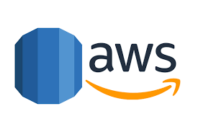

RDS (AWS)
Amazon Relational Database Service
Automates provisioning, configuring, backups, patching
Primary instance and backup instance
Supports 8 DB engines & 2 deployment models
Oracle Database
MySQL
IBM
MariaDB
Microsoft SQL Server
PostgreSQL

Slide 48
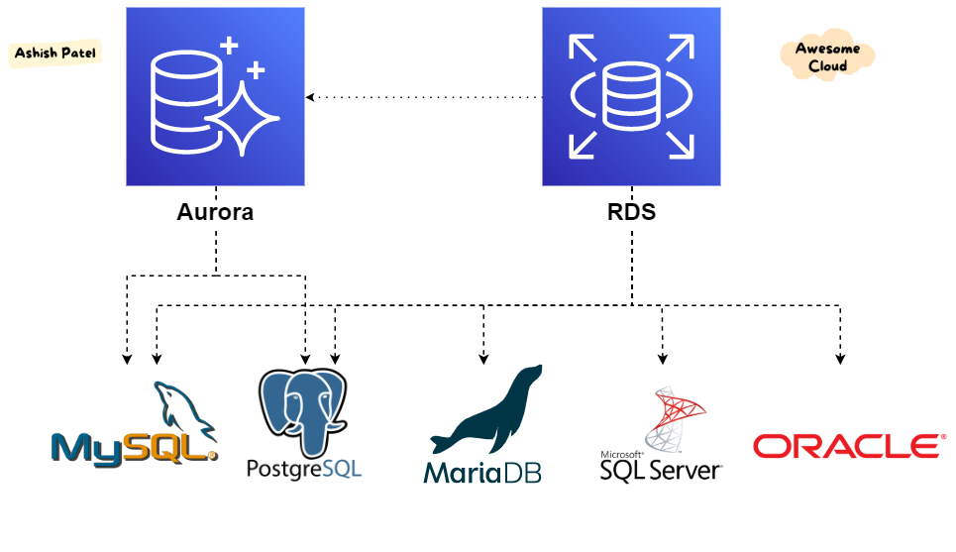
Amazon Aurora
Fully managed relational db
Scales automatically
Compatible with MySQL and PostgreSQL
Deployed as a cluster w/ primary and replica nodes
Aurora replica lag == milliseconds
RDS replica lag == minutes

Slide 49
Aurora (AWS)
Two kinds of Aurora databases:
Aurora Serverless:
Sporadic usage workloads or unpredictable usage
Pay for DB storage on a per-second basis
Provides a more cost-effective option than regular DB management in certain use cases
Global Database
For globally distributed applications
Faster physical replication between aurora clusters
At least 2 regions
Recovery Point Objective =1 second
Avoid data loss
Recovery Time Objective = 1 minute

Slide 50
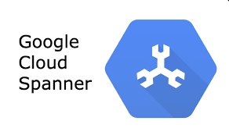
Spanner (GCP)
Replicates data across global data centers
Consistently available even during updates
SQL-compatible
Use cases:
Globally distributed apps
Mission-critical data
Real-time action
Big data
Supports:
relational, graph, key value, search
Point-in-time recover within microseconds
99.999% SLA
Automatic replication

Slide 51
CLOUD-Managed Databases
(CLOUD) MANAGED
TRADITIONAL
CLOUD-NATIVE
SQL
NoSQL
SQL
NoSQL
Azure SQL
CosmosDB (Azure)
Aurora (AWS)
DynamoDB (AWS)
RDS (AWS)
BigTable, Firestore, Memorystore, (GCP)
Cloud Spanner (GCP)

Slide 52

Cosmos DB (Azure)
Works with four data models
Document store
Graph oriented
Key-value store
Wide-column store
Foundational Azure service
Available in every region in Azure
Automatically indexes your data
Scales storage and throughput independently
Request units
Cosmos DB performance currency
Supports open source API and access methods
Cassandra, MongoDB
Not alternative or replacement to SQL server

Slide 53
Cosmos DB (Azure)
Good for cloud-first applications
Supports a SQL-like language
Scaling options:
Scaling SQL Server
Handle transactions sequentially
Single source of truth
Replicated out
CosmosDB scales with more machines
All nodes can accept both reads and writes
Indexing supports both the data and UIDs

Slide 54
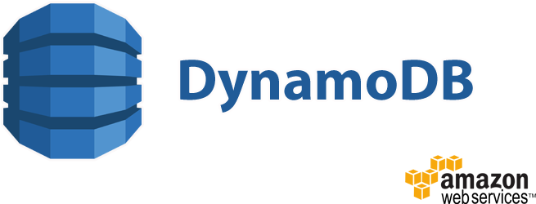
DynamoDB (AWS)
People
{
"PersonID": 101,
"LastName": "Smith",
"FirstName": "Fred",
"Phone": "555-4321"
}
{
"PersonID": 102,
"LastName": "Jones",
"FirstName": "Mary",
"Address": {
"Street": "123 Main",
"City": "Anytown",
"State": "OH",
"ZIPCode": 12345
}
}
{
"PersonID": 103,
"LastName": "Stephens",
"FirstName": "Howard",
"Address": {
"Street": "123 Main",
"City": "London",
"PostalCode": "ER3 5K8"
},
"FavoriteColor": "Blue" }
AWS key-value datastore
99.999% SLA
Scale-to-zero serverless
Use boto3 to interact with python

Slide 55
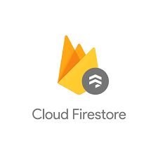
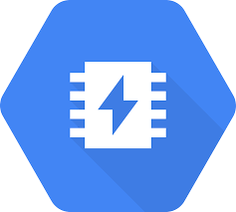
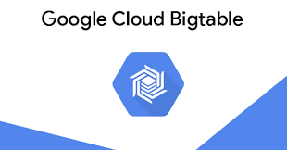
GCP Cloud-Native Databases
BigTable
Key-value
Firestore
Document database
Memorystore
In-memory database

Slide 56
Cloud Databases: Full Picture
SELF-MANAGED
(CLOUD) MANAGED
TRADITIONAL
CLOUD-NATIVE
SQL
NoSQL
SQL
NoSQL
MySQL
MongoDB
Azure SQL
CosmosDB (Azure)
SQL Server
Cassandra
Aurora (AWS)
DynamoDB (AWS)
Oracle
CouchDB
PostgreSQL
RDS (AWS)
BigTable, Firestore, Memorystore, (GCP)
Cloud Spanner (GCP)
MariaDB

Slide 57
Land Acknowledgement Statement
We respectfully acknowledge the University of Arizona is on the land and territories of Indigenous peoples. Today, Arizona is home to 22 federally-recognized tribes, with Tucson being home to the O’odham and the Yacqui. Committed to diversity and inclusion, the University strives to build sustainable relationships with sovereign Native Nations and Indigenous communities through education offerings, partnerships, and community service.

